Slide 1
Innovative Examples of Artificial Intelligence in Retail

Slide 2
Some key takeaways of AI in Retail

Slide 3
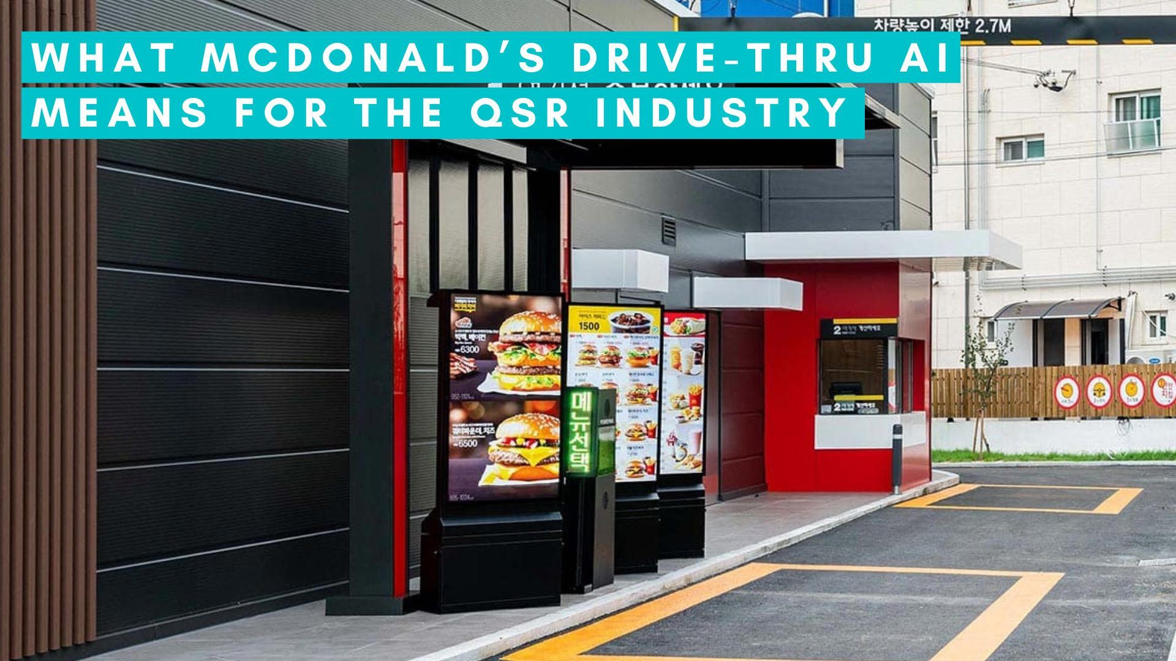
Personalization: AI is being used to provide personalized recommendations and tailored shopping experiences. Companies like mcdonald's, stitch fix, and jetblack are leveraging ai algorithms to understand customer preferences and offer customized suggestions.

Slide 4
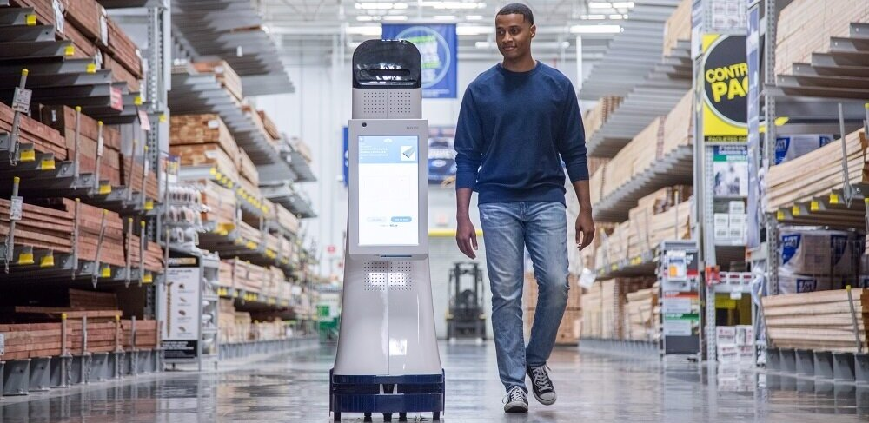
Enhanced customer service: AI-powered solutions, such as lowebot and virtual baristas, are being utilized to improve customer service. These technologies can answer customer queries, provide product information, and assist with finding items in-store, creating a more seamless and efficient shopping experience.

Slide 5
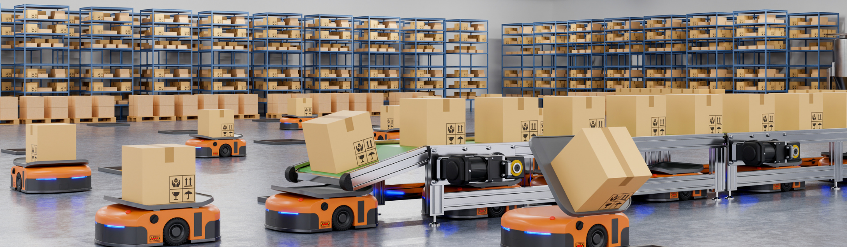
Inventory management: AI is revolutionizing inventory management by enabling real-time tracking, optimizing stock levels, and automating restocking processes. Walmart's intelligent retail lab and amazon go are examples of how ai and computer vision technologies are used to monitor inventory and ensure product availability.

Slide 6
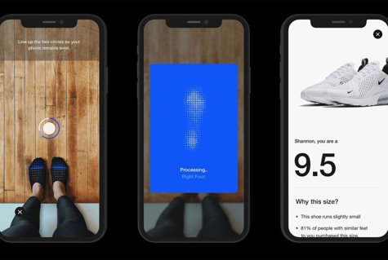
Visual Recognition: Retailers are leveraging AI-based visual recognition technologies to enhance shopping experiences. Features like Nike Fit, Amazon StyleSnap, and Neiman Marcus' Snap. Find. Shop. enable customers to find the perfect fit or search for similar products by simply uploading images or using their smartphone cameras.

Slide 7
Automation and Efficiency: AI is streamlining various retail processes, such as grocery shopping lists (Sam's Club Now), checkout systems (Amazon Go), and pricing optimization (Kroger EDGE). These innovations aim to save time for customers and improve operational efficiency for retailers.
Data-driven Insights: AI-powered solutions generate vast amounts of data, allowing retailers to gain valuable insights into customer behavior, preferences, and trends. This data can be used to refine recommendations, personalize marketing efforts, and make predictive inventory decisions.

Slide 8
How many examples do you know of AI in Retail ?

Slide 9
Conclusion
Artificial Intelligence is reshaping the retail industry by offering personalized experiences, improving operational efficiency, and transforming various aspects of the customer journey. As technology continues to advance, we can expect further innovations and integration of AI in retail, ultimately improving the overall customer experience.

